Slide 1
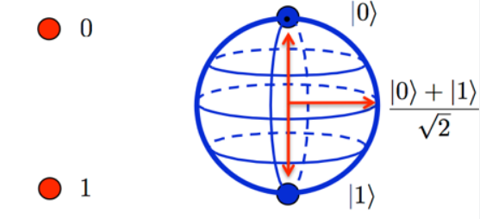
Quantum Superposition

Slide 2

Quantum System
Quantum systems are linear systems: "The quantum states are represented by vectors and quantum operators are represented by matrices. The new quantum states are calculated by corresponding matrix-vector multiplications."
Just like a binary bit is the basic unit of information in classical (or traditional) computing, a qubit (or quantum bit) is the basic unit of information in quantum computing. Quantum computing is driving new discoveries in healthcare, energy, environmental systems, smart materials, and beyond.
A qubit uses the quantum mechanical phenomena of superposition to achieve a linear combination of two states. A classical binary bit can only represent a single binary value, such as 0 or 1, meaning that it can only be in one of two possible states. A qubit, however, can represent a 0, a 1, or any proportion of 0 and 1 in superposition of both states, with a certain probability of being a 0 and a certain probability of being a 1.
A qubit (quantum bit) has two states: state 0 and state 1.
They are denoted by ket-notation:

Slide 3



NOT operator
NOT operator flips the value of a qubit.
We use capital letter for the matrix form of the operators:
The action of 𝑋 on the qubit: 𝑋|0⟩=|1⟩
More explicitly,
Similarly, 𝑋|1⟩=|0⟩
More explicitly,

Slide 4
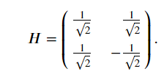

Hadamard operator
Hadamard operator (𝐻 or h-gate) looks similar to a fair coin-flipping.
But, there are certain dissimilarities:
we have a negative entry, and instead of ½
we have its square root

Slide 5
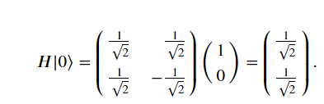
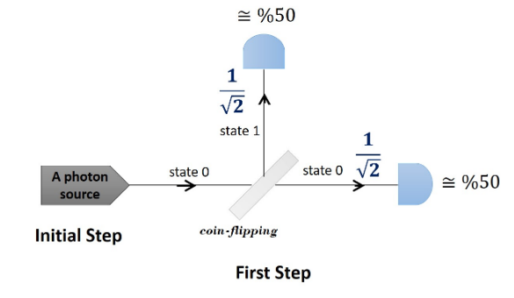
One-step Hadamard
Start in |0⟩ After applying 𝐻 :
After measurement, we observe the states |0⟩ and |1⟩ with equal probability 1/2.

Slide 6
Quantum Superposition
Quantum superposition is a fundamental principle of quantum mechanics. In classical mechanics, things like position or momentum are always well defined. In quantum mechanics, a particle can be in a superposition of different states. It can be in two places at once (see Coin-flipping experiment). A measurement always finds it in one state, but before and after the measurement, it interacts in ways that can only be explained by having a superpositions of different states.

Slide 7
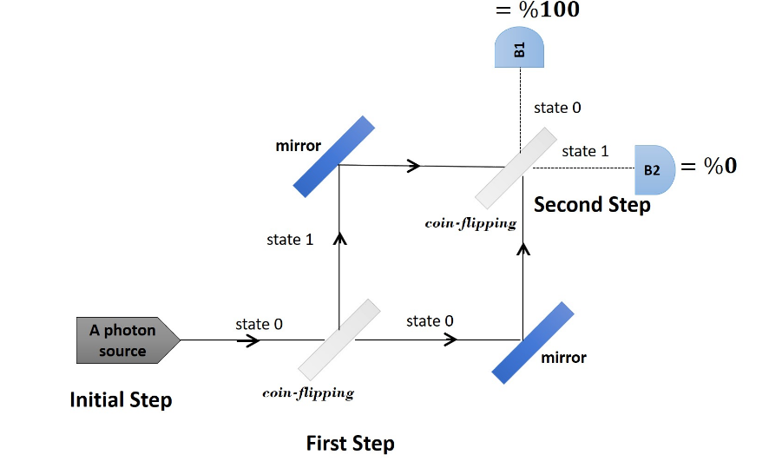
Coin-flipping experiment
We trace it step by step by matrix-vector multiplication.

Slide 8

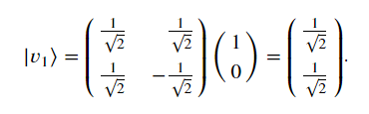



The initial Step
The photon is in state
The first step
Hadamard is applied:
At this point, the photon is in a superposition of state |0⟩ and state |1⟩, being in both states with the amplitudes
, respectively.
The state of photon is and we can also represent it as follows:

Slide 9
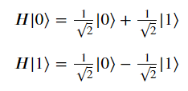

The second step
Hadamard is applied again:
We write the effect of Hadamard on states |0⟩ and |1⟩ as follows:
(These are the transition amplitudes of the first column.)
(These are the transition amplitudes of the second column.)
This representation helps us to see clearly why the state |1⟩ disappears.
Now, let's see the effect of Hadamard on the quantum state

Slide 10

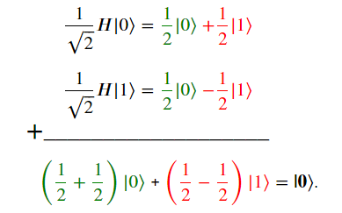
We can replace 𝐻|0⟩ and 𝐻|1⟩ as described above. |V2⟩ is formed by the summation of the following terms:
The amplitude of |0⟩ becomes 1, but the amplitude of |1⟩ becomes 0 because of cancellation.

Slide 11
The photon was in both states at the same time with certain amplitudes.
After the second Hadamard, the "outcomes" are interfered with each other.
The interference can be constructive or destructive. In our examples, the outcome |0⟩ are interfere constructively, but the outcome |1⟩ are interfered destructively.
Being in a superposition
A quantum system can be in more than one state with nonzero amplitudes.
Then, we say that our system is in a superposition of these states.
When evolving from a superposition, the resulting transitions may affect each other constructively and destructively.
This happens because of having opposite sign transition amplitudes.
Otherwise, all nonzero transitions are added up to each other as in probabilistic systems.

Slide 12
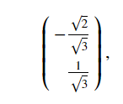
Measurement
We can measure a quantum system, and then the system is observed in one of its states. This is the most basic type of measurement in quantum computing. The probability of the system to be observed in a specified state is the square value of its amplitude.
If the amplitude of a state is zero, then this state cannot be observed.
If the amplitude of a state is nonzero, then this state can be observed.
For example, if the system is in quantum state
then, after a measurement, we can observe the system in state |0⟩ with probability ⅔ and in state |1⟩ with probability ⅓

Slide 13


Collapsing
After the measurement, the system collapses to the observed state, and so the system is no longer in a superposition. Thus, the information kept in a superposition is lost.
In the above example, when the system is observed in state |0⟩ then the new state become
if it is observed in state |1⟩, then the new state becomes

